Slide 1


Youtube Channel Performance Analysis
Company Name : Trendalytix
Team Number : 12
Team lead : Snigdha gaur
Team members : Arpita sharma
vishesh Parashar
shakthi m

Slide 2
A clear interpretation of what the problem is asking
The objective is to conduct comprehensive analysis of Youtube video performance data with vast number of KPIs in order to identify which types of content generate the highest level of audience engagement. Based on this insights derived from the analysis, the goal is to provide data driven recommend strategies to enhance and optimize future content for better performance and sustained growth.

Slide 3
Any Key Requirements and Constraints
Constraints
Policy
Privacy
Copyright
Data Availability
Time Constraints
Audience Behavior
Seasonality Content
Legal and Compliance Restraints
Key Requirements
Structured Data
Storing Dataset
Cleaning
Transformation
Mining
Statistical Analysis
Key Performance Indicators
Likes
Views
Duration
Hashtags
Video Title
Comments
Watch Time
Upload Date
Subscriber Growth
Audience Engagement Rate

Slide 4
Initial Thought to solve the problem
Our core goal is to analyze video performance data specifically all the key performance indicators and constraints that we have mentioned in above slide to determine which type of content drive the most audience engagement and how to optimize future videos and overall content strategy. The ultimate goal is to derive actionable insights and formulate strategic recommendations to optimize future content planning and production.

Slide 5
Our Approach to solve the problem
Collect and Organize Data
We have collected data of two months .i.e. April and May 2025, for each video and shorts
Converted it into a dataframe using tool Microsoft Excel.
Analyzing Key Metrics
Engagement Rate = (Likes + Comments) / Views
Watch Time Per view = Watch time / Views
Comparing Uploading dates /days , Video Duration etc.
Posting Frequency
Exploratory Data Analysis
We will perform visual and statistical analysis to uncover insights : Trend, Engagement Patterns, Format Patterns and correlation between KPIs
For this we are going to use Python and its libraries, Power BI etc.
Insights and Recommendation
Derive actionable insights to inform content planning : Topics and formats which lead to subscriber growth, Common high performing hashtags and titles etc.

Slide 6
Tools and its Purpose
Microsoft Excel – Data collection and Cleaning Data
SQL – Data Extraction and Filtering
Power BI - Visualization and Reporting
ML Algorithms - Predictive Modeling
Python - Deep Analysis and Automation
Python Libraries- Numpy, Pandas and Scikit

Slide 7

Chef Prateek’s Kitchen Channel
Chef Prateek’s Kitchen is a popular Indian YouTube channel run by 25 years old certified Chef Prateek.
Launched in July 2021, the channel focuses on teaching easy-to-follow cooking recipes tailored for home cooks.
From traditional Indian dishes to creative meals, Chef Prateek shares step-by-step tutorials with clear instructions in his youtube videos and shorts.
Channel Overview
Subscribers : ~4.7 M
Total Views : ~2.6 B
Video Published : ~1 K in 3 years

Slide 8
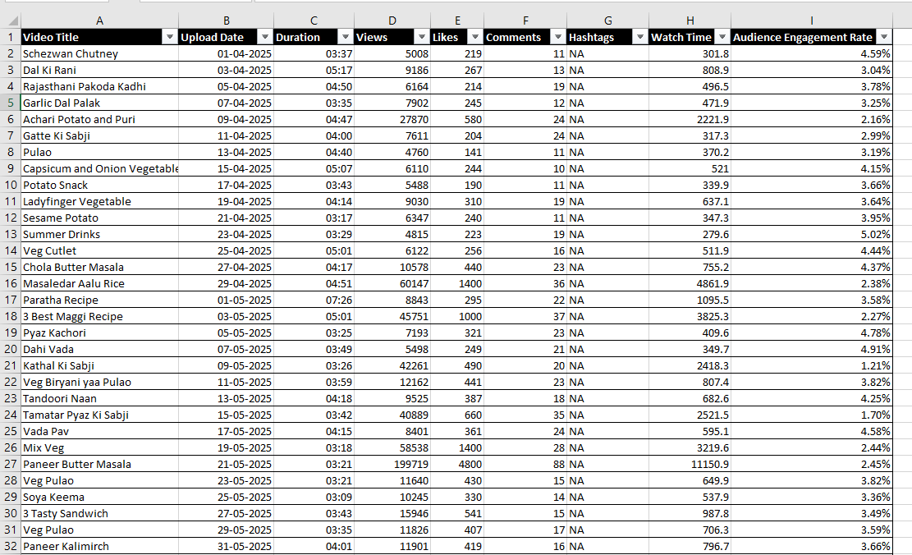
Data Set of his channel’s videos April and May 2025
Fig 1: Excel containing realtime data of month may

Slide 9
Deliverables and Conclusion
A comprehensive analytical report, including visualizations and key performance indicators. A summary of top-performing content characteristics. Strategic recommendations to optimize content creation and publishing practices.
This analysis aims to provide a data-driven understanding of what drives engagement on the YouTube channel. By leveraging both descriptive and predictive analytics, the goal is to inform a content strategy that enhances audience growth, increases engagement, and ultimately improves the channel’s overall performance.

Slide 10
Thankyou
Sources link : Chef Prateek’s kitchen Channel
https://youtube.com/@chefprateekskitchen?si=aiiCUEfPmEvUCc3L
Youtube Channel Performance Analysis
Project by Team No. 12
Snigdha Gaur
Arpita Sharma
Vishesh Parashar
Shakthi M

